Slide 1
CNAViz: User-guided local and global copy-number segmentation for tumor sequencing data
05-20-2022
Zubair Lalani^{*, 1}, Gillian Chu^{*, 1}, Silas Hsu¹, Simone Zaccaria^{†, 2, 3}, and Mohammed El-Kebir^{†, 1, 4}
¹ Department of Computer Science, University of Illinois at Urbana-Champaign, ² Computational Cancer Genomics Group, University College London Cancer Institute ³ , Cancer Research UK Lung Cancer Centre of Excellence, University College London Cancer Institute, ⁴ Cancer Center at Illinois, University of Illinois Urbana-Champaign
* joint first-author, † corresponding author
Notes:
17 minutes for presentation
https://uofi.app.box.com/integrations/googledss/openGoogleEditor?fileId=716826966456&trackingId=3#slide=id.p21
https://uofi.app.box.com/folder/115977193972
https://www.overleaf.com/project/61c35ada97fdba8804036852
https://elkebir-group.github.io/cnaviz/

Slide 2
Cancer Evolution
Clonal Evolution Theory of Cancer
[Nowell, 1976]
Notes:
So to start of by grounding ourselves in the original theory of cancer:
All cells accumulate mutations. Over time, tumor clones develop different sets of mutations, and we refer to these as clones.
Eventually, these clones become different enough, at which point we refer to as inter-tumor heterogeneity.
There are many types of somatic mutations (SNVs, to large copy number aberrations - show graphic)

Slide 3
Cancer Evolution
Cancer Evolution
maternal
paternal
Notes:
There are many types of somatic mutations (SNVs, to large copy number aberrations)
in a normal autosomal cell - two copies, maternal, paternal
A copy number aberration changes the copy number (paternal copy now has 2 copies),
Thus, where the total copy number for the yellow gene was 2, now it’s 3.
However, copy number calling is challenging.

Slide 4
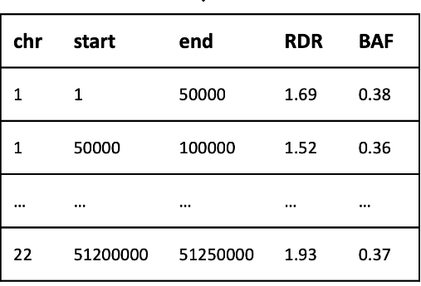
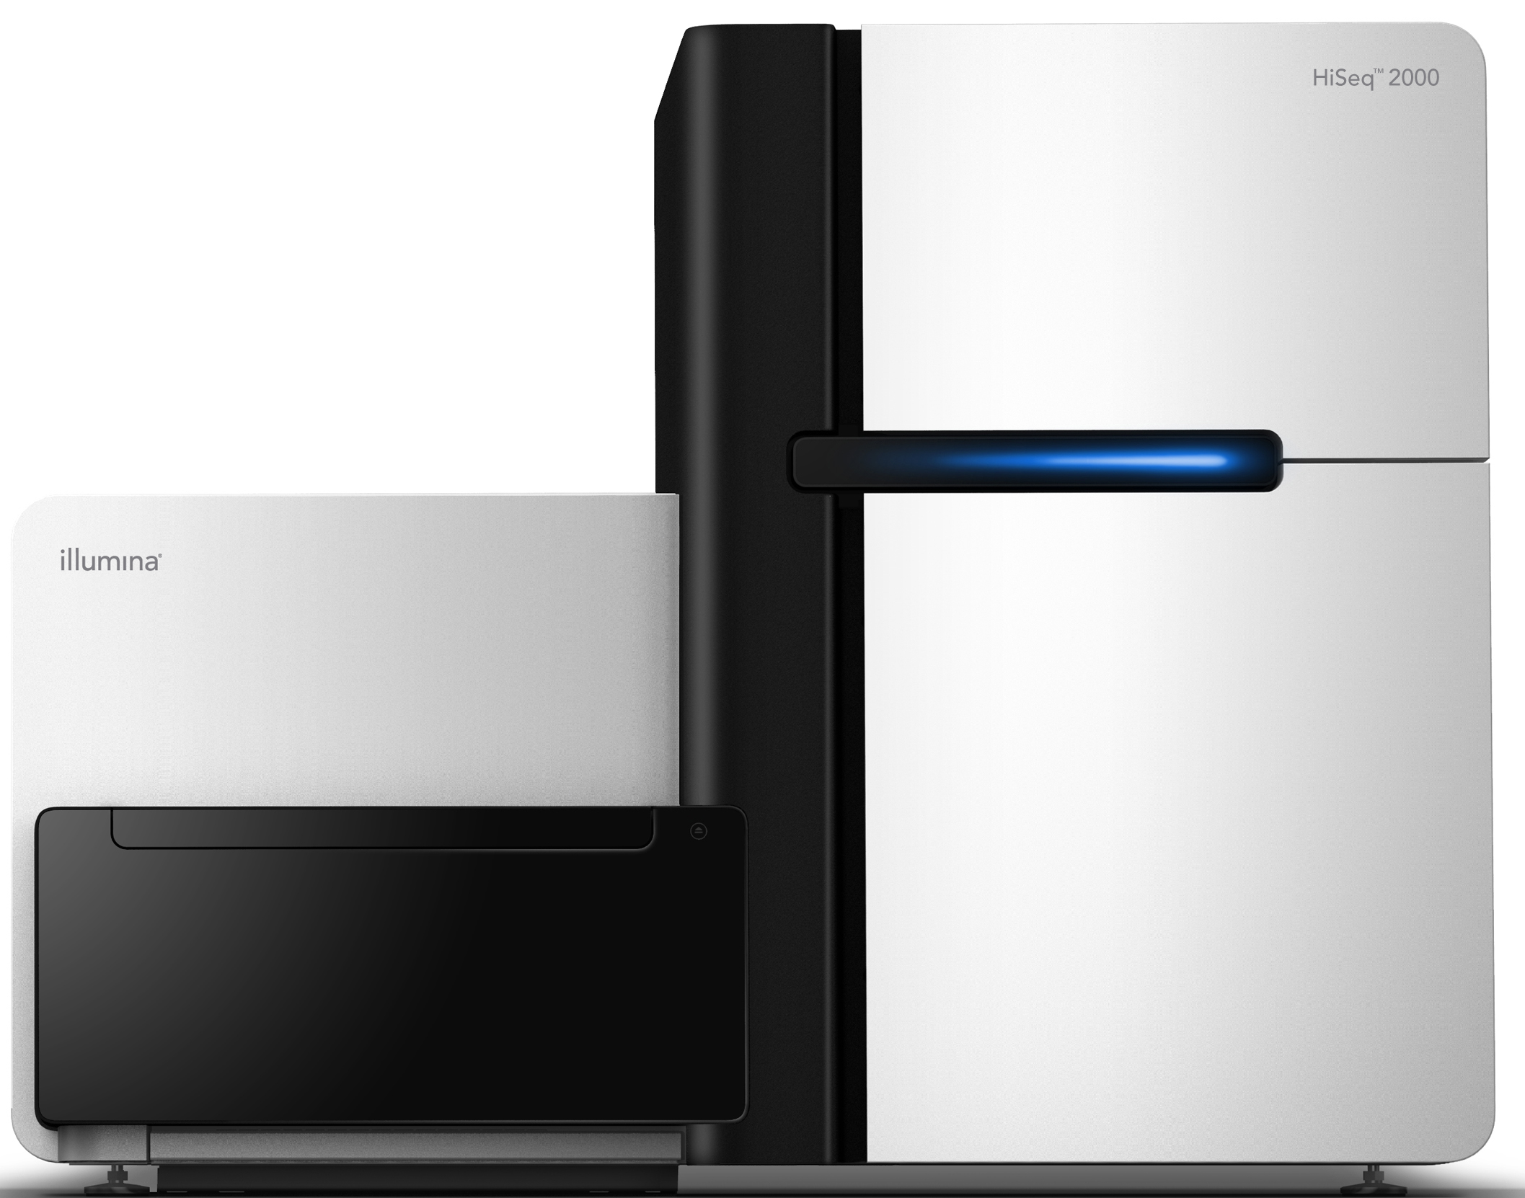
Understanding Heterogeneity
Understanding Heterogeneity
Heterogeneous tumor
read
reference
…
genome
(matched normal sample)
bin
…
(tumor sample)
reference
genome
bin
Notes:
To start off the process of understanding copy number calling:
The first step is typically DNA sequencing. We obtain some reads, which fall into bins –depending on the sequencing technology, typically 50 kb
For every bin, this gives us an an understanding of two measures:
read depth ratio, which is proportional to copy number
allelic imbalance (BAF), prop between maternal and paternal

Slide 5
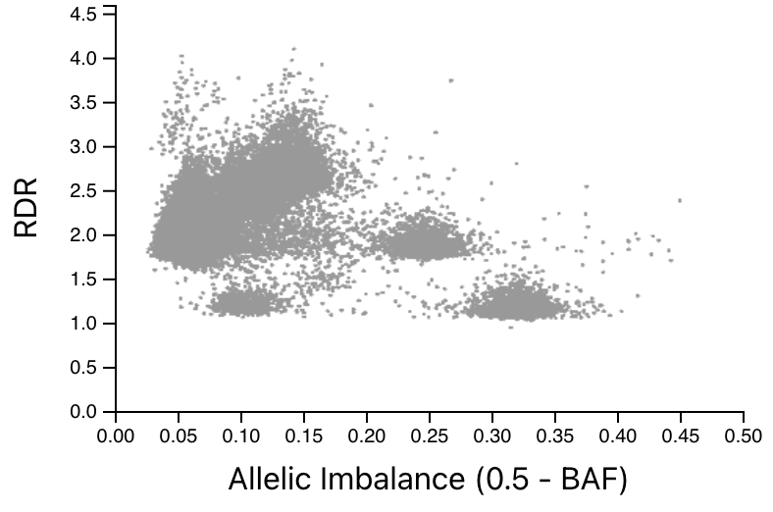
Understanding Heterogeneity
Understanding Heterogeneity
Notes:
We put all of this in a scatter plot, to create what we call a global view
So here we’re looking at an actual patient, A12.
Each bin is a point on the scatter plot.
RDR is on the y axis, allelic imbalance is on the x axis.
So to recall, RDR is proportional to copy number, so if it’s close to 1, we have it very balanced (probably heterozygous diploid)
So with that as our point of origin, we can start to see where bins might lie in relation to our point of origin, and feasibly perform copy number calling.
However you’ll notice that the scatter plot is all grayed out.
So the next step is to color the bins (which we call segmentation), so that copy number calling can occur.
This is the step we’re going to focus on today.

Slide 6
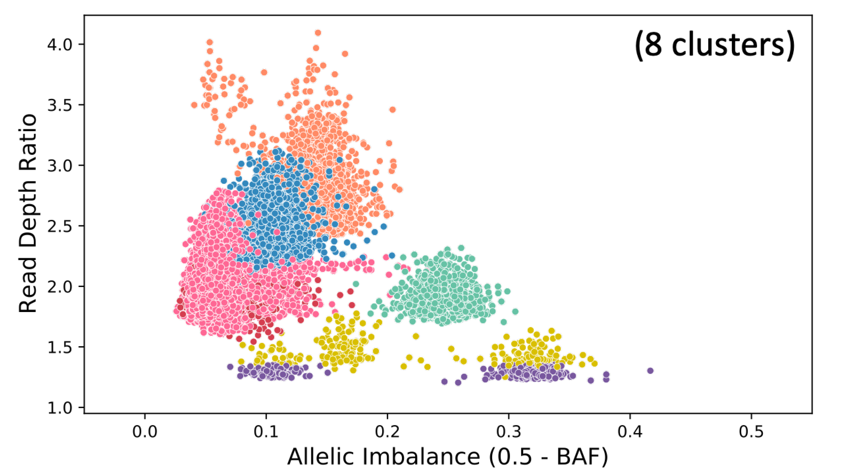
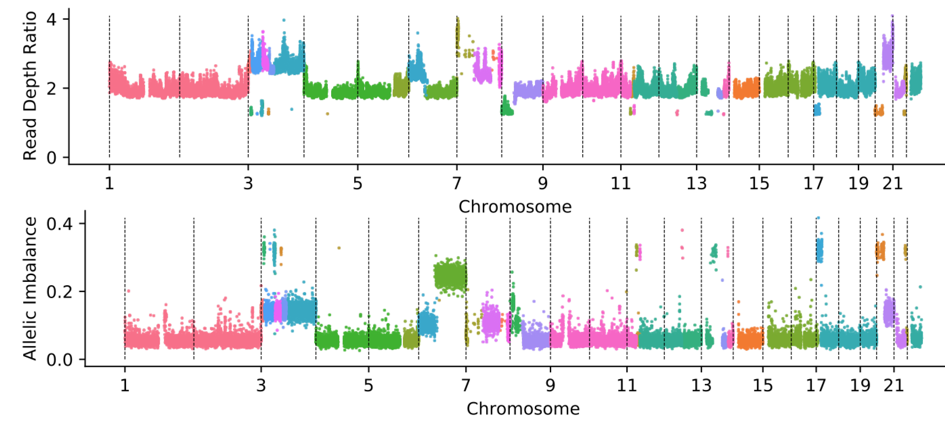
Segmentation
Segmentation
Local segmentation
via ASCAT [Van Loo et al., PNAS 2010]
Global segmentation
via HATCHet [Zaccaria et al., Nature 2020]
43 segments
8 segments
Notes:
There are two main approaches to segmentation: (coloring the bins)
Each color corresponds to a segmentation
The local view (on the left), lays the bins out in a linear plot, and segments them incorporating information about where each chromosome starts and ends
The global view (on the right), incorporates information across the genome
both have pros and cons
(in particular, local segmentation leads to some overfitting with 43 clusters, and global segmentation overfits in the other direction with 8 clusters).
We can also see examples of this, where in the local segmentation case the long stretch that share RDR and BAF values should all be one segmentation and therefore one color
In the global segmentation case, we have bins that look like they should be clustered together, but have been lumped together.
The truth is probably somewhere closer to the middle, so our task is to improve on both of these approaches.

Slide 7
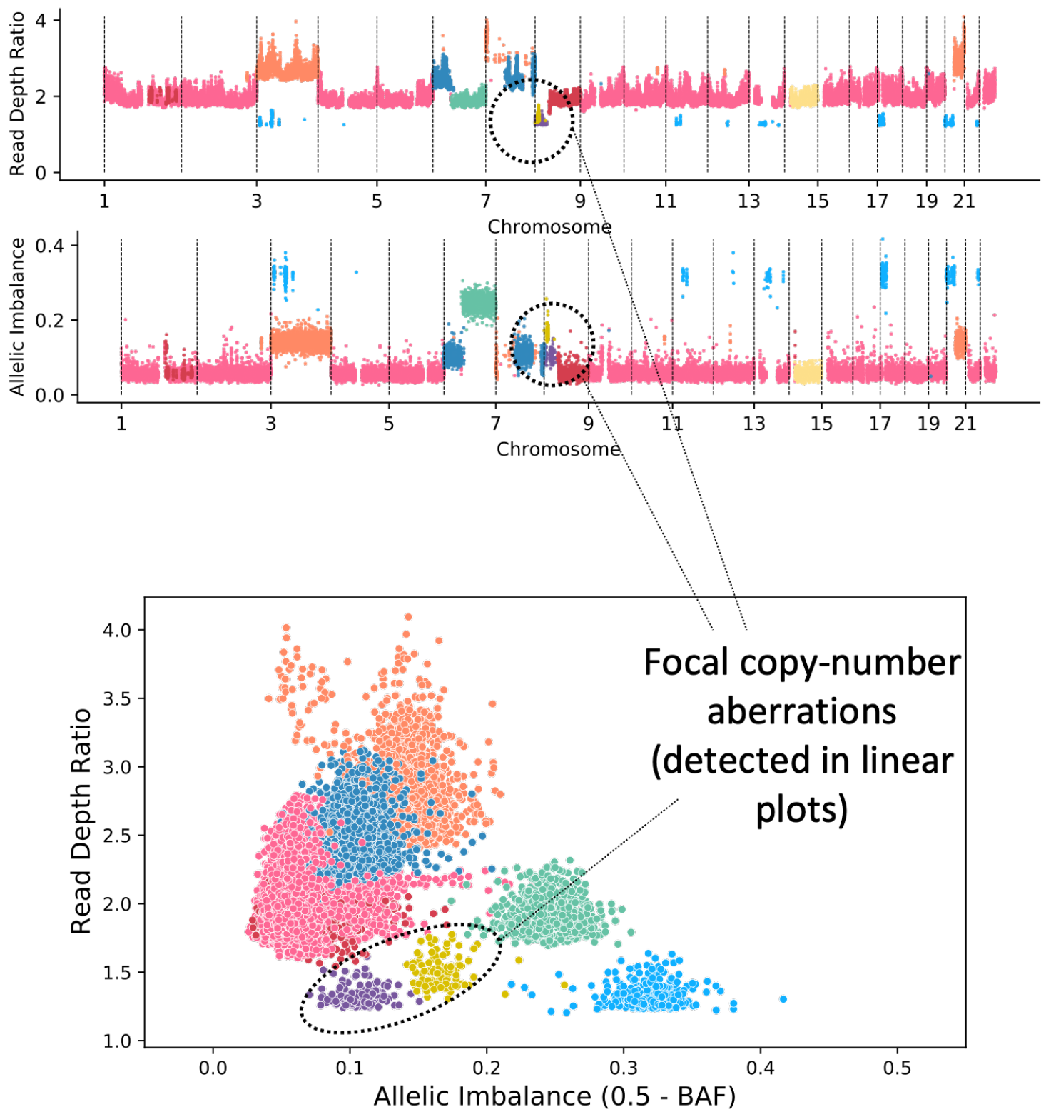
CNAViz: New Insights
Understanding Heterogeneity
By using CNAViz to combine local and global segmentation, we can identify focal copy-number aberrations.
Notes:
Perhaps most importantly, by combining these two approaches, we can identify important copy-number aberrations.
This was the focus of our paper. We developed a user-guided tool that would leverage the advantages of both approaches.

Slide 8
Overview
CNAViz Toolkit
Overview
Coordinate Plots
Linear Plots
Exploration of Simulated Data
Results on Biological Data
Concluding Remarks

Slide 9
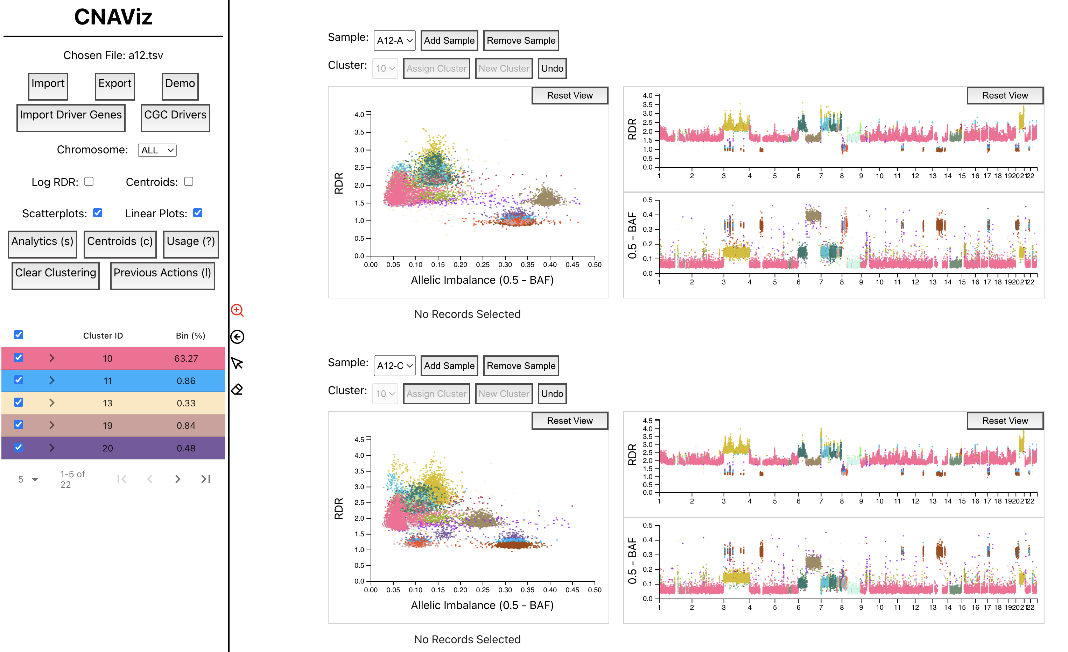
CNAViz Toolkit: Overview
CNAViz Toolkit: Overview
Notes:
The toolbar on the left hand side illustrates which clusters and chromosomes are showing, and provides other useful tooling we’ll introduce today.
We can visualize several samples for each patient at once.
We can visualize both the coordinate and the linear plots.

Slide 10
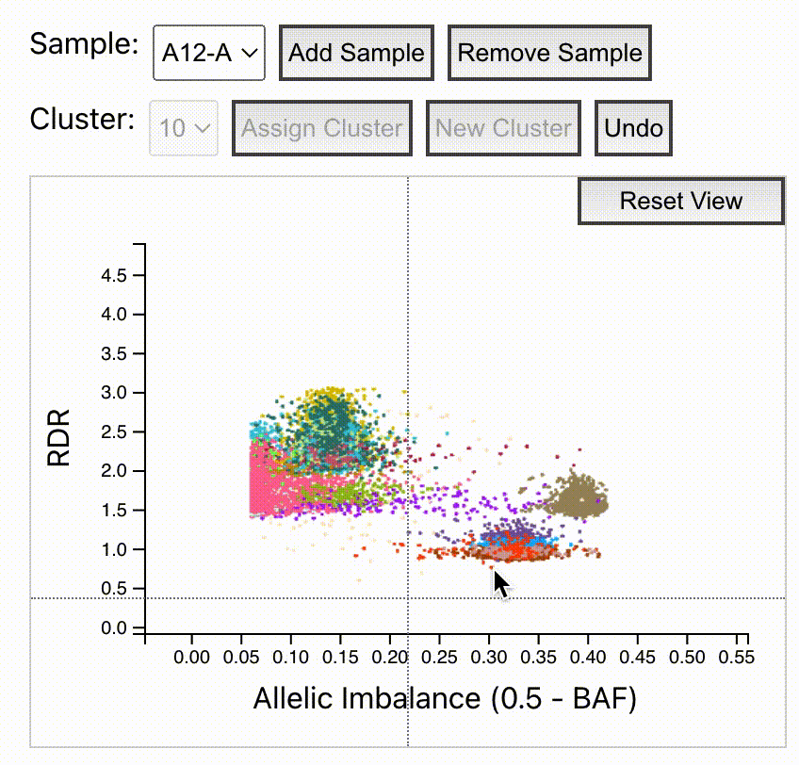
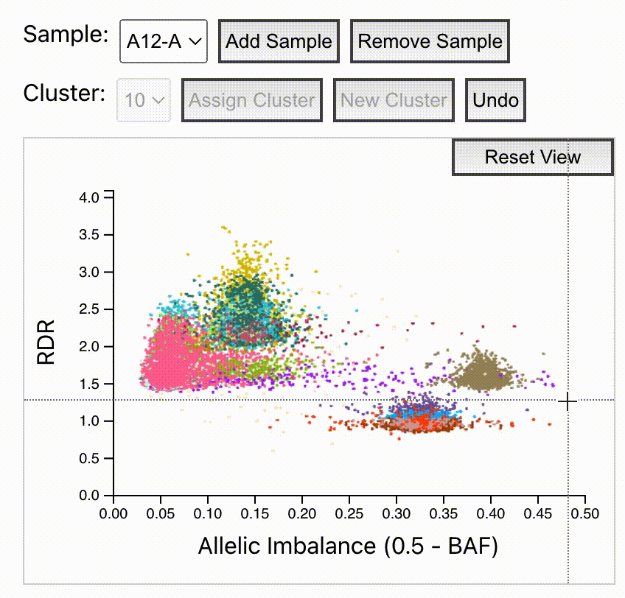
CNAViz Toolkit: Coordinate Plots
CNAViz Toolkit: Coordinate Plots

Slide 11
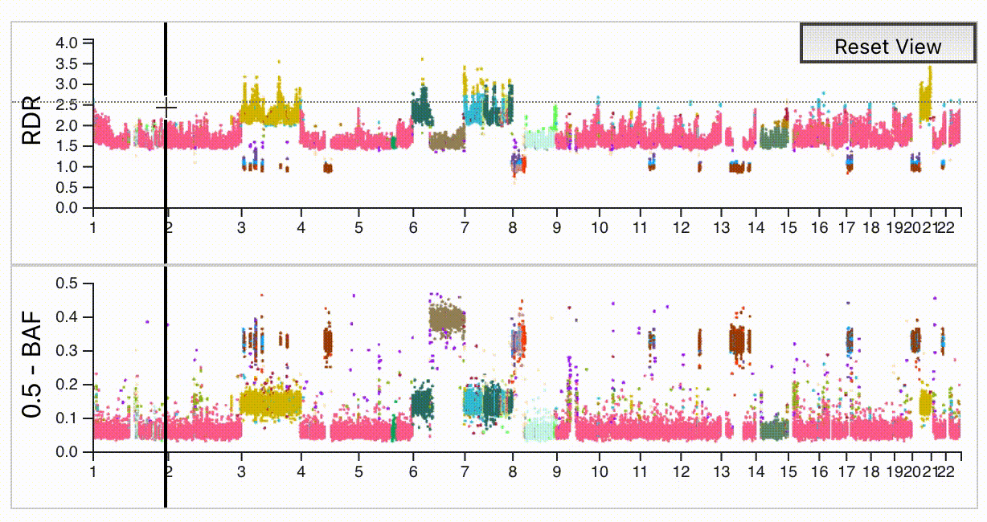
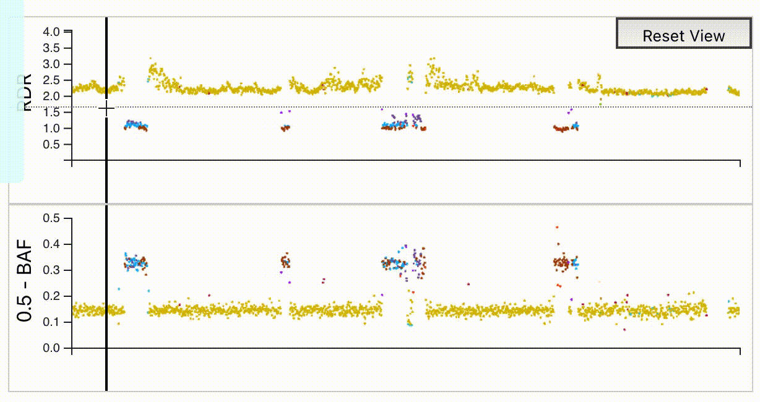
CNAViz Toolkit: Linear Plots
CNAViz Toolkit: Linear Plots

Slide 12
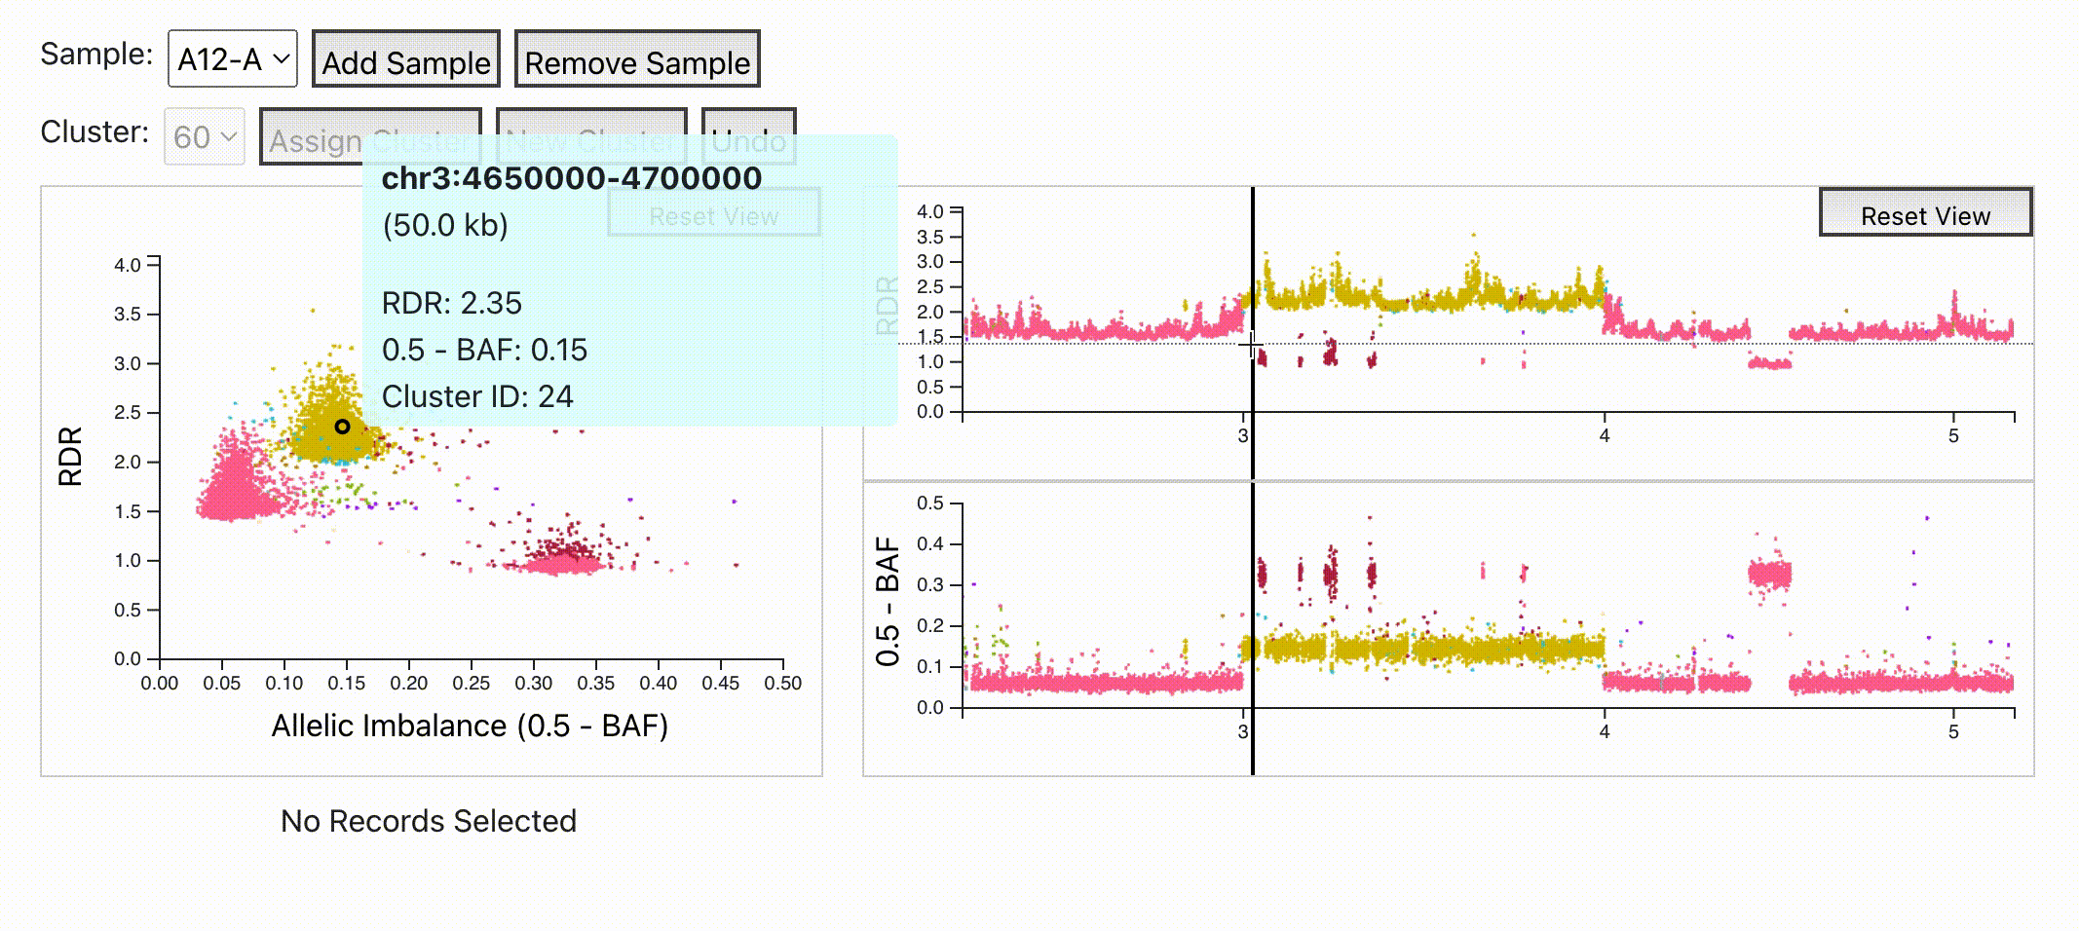
CNAViz Toolkit: Linear and Global Synced
CNAViz Toolkit: Linear and Global Synced

Slide 13
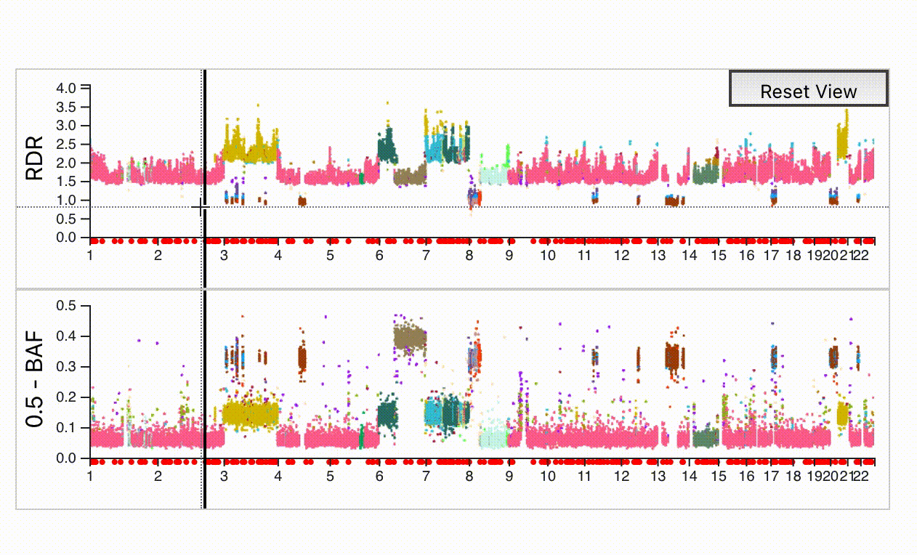
CNAViz Toolkit: Gene Annotations
CNAViz Toolkit: Gene Annotations

Slide 14
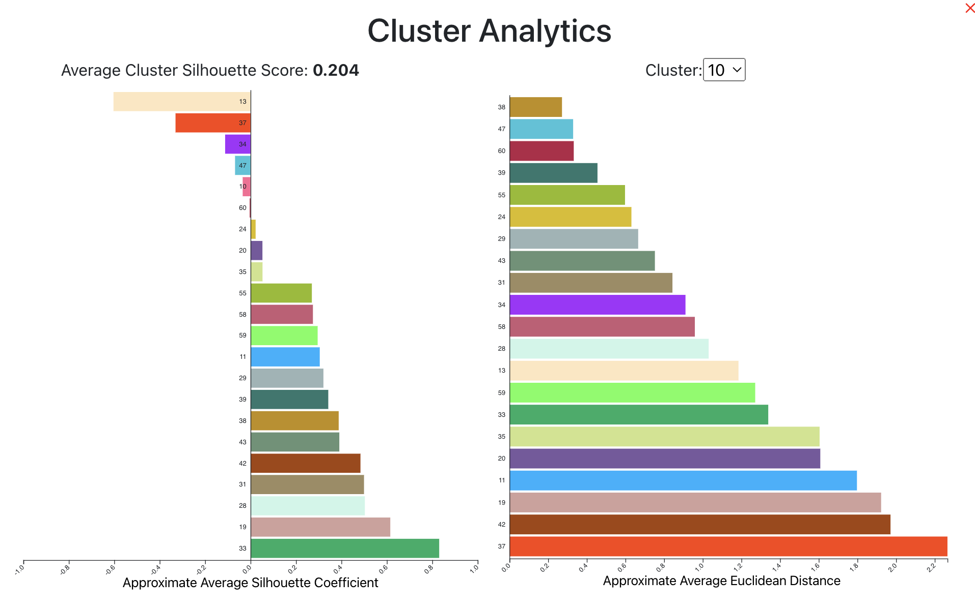
CNAViz Toolkit: Clustering Analysis
CNAViz Toolkit: Gene Annotations
Which clusters should
be merged?
Homogeneity
&
Separation?
[Rousseeuw et al. 1987]
Notes:
-1 and 1, high value indicates homogeneity (bins are well matched to other bins in the same cluster) and also separation (poor matches to bins from other clusters)
Euclidean distance is to indicate which clusters should be merged

Slide 15
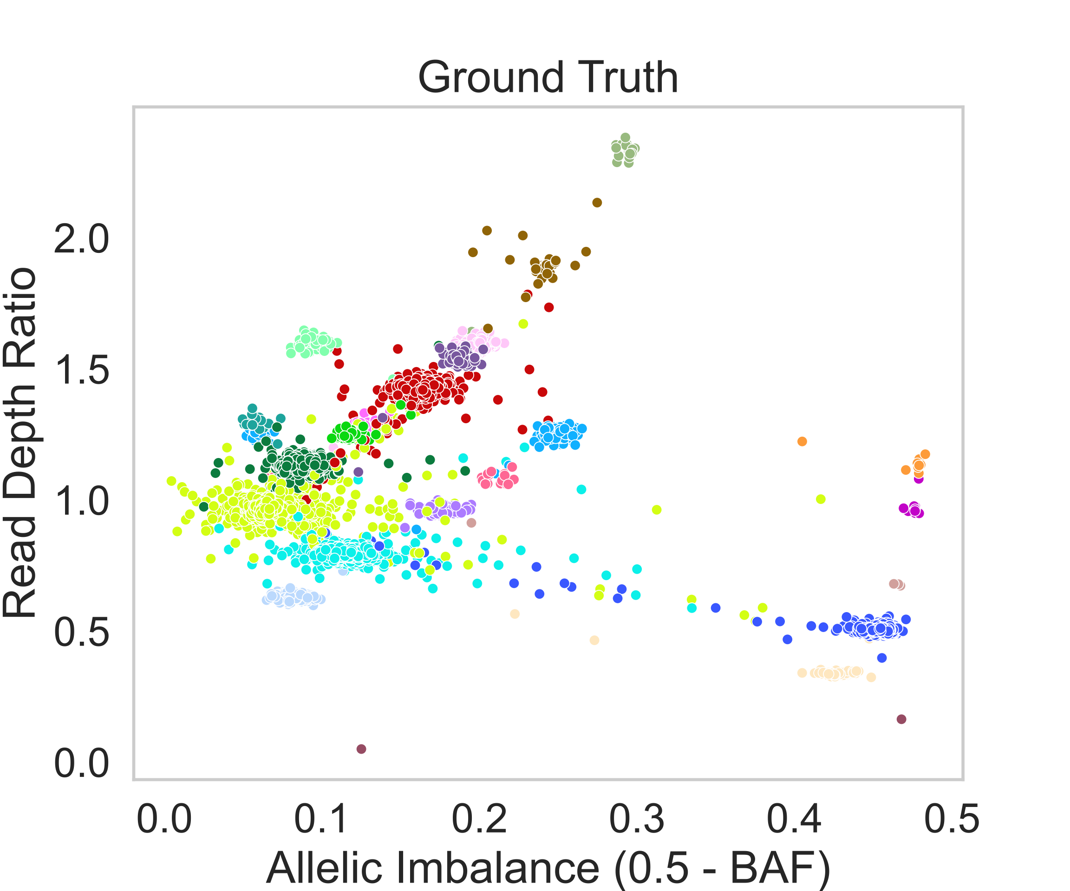
Simulated Data: Results
Simulated Data: Results
[Zaccaria et al., Nature 2018]
Method | # Clusters | Adjusted Rand Index | V-measure | Silhouette Score
Ground Truth | 22 | - | - | 0.892
CNAViz | 24 | 0.99553 | 0.97048 | 0.905
HATCHet | 18 | 0.99457 | 0.96303 | 0.810
HATCHet + CNAViz | 24 | 0.99539 | 0.96983 | 0.956
ASCAT | 69 | 0.07376 | 0.21984 | -0.454
ASCAT + CNAViz | 21 | 0.99509 | 0.96804 | 0.888

Slide 16
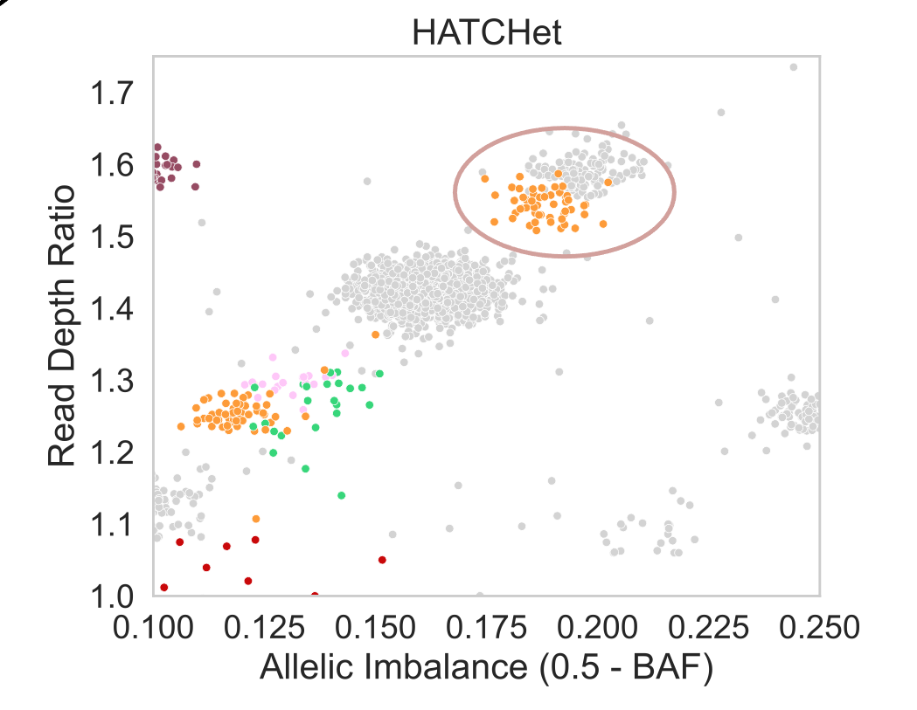
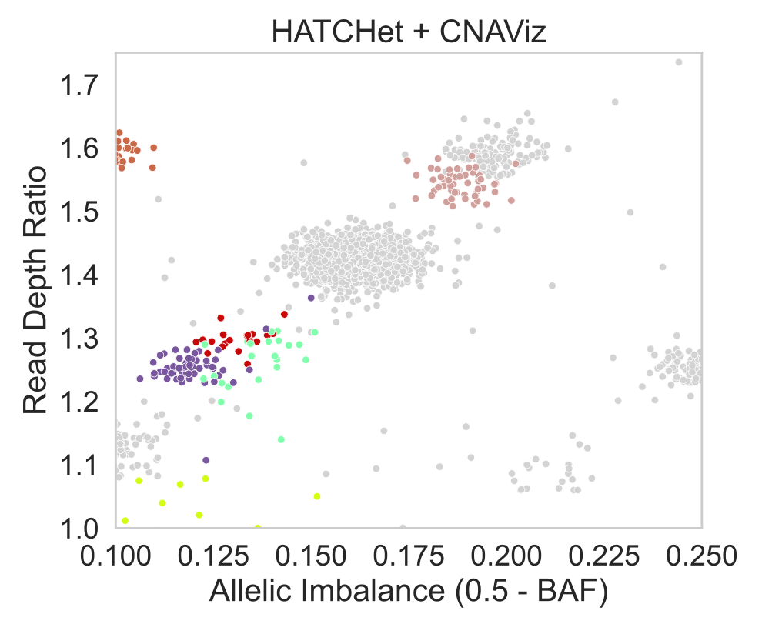
Simulated Data: Before and After CNAViz
Simulated Results: Before and After CNAViz

Slide 17
Simulated Data: Before and After CNAViz
Simulated Results: Before and After CNAViz

Slide 18
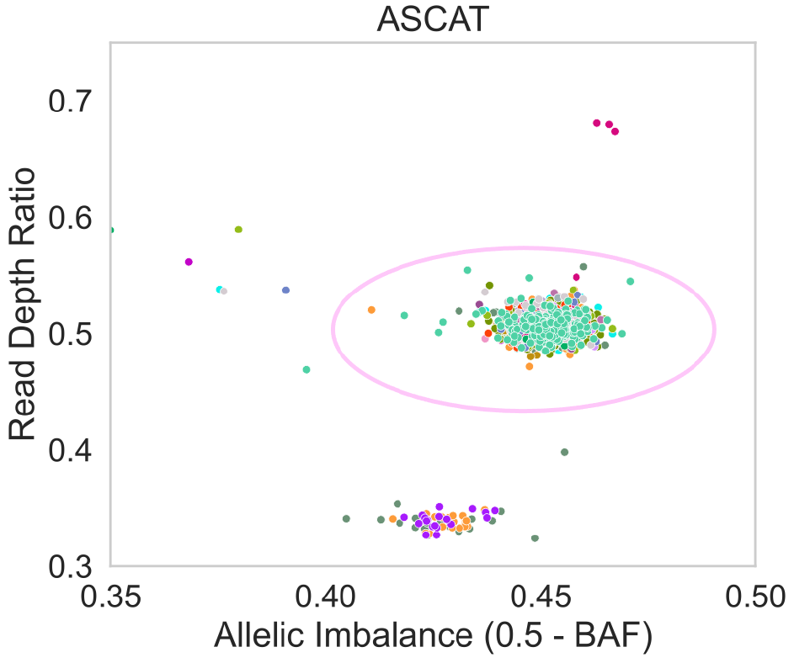
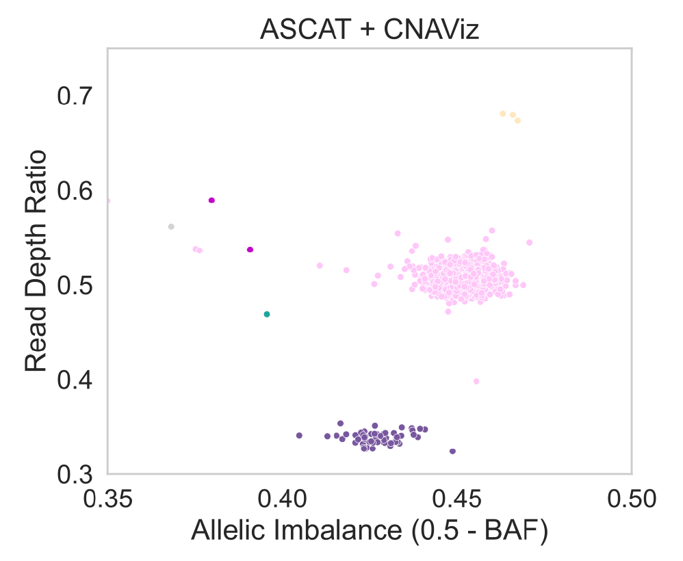
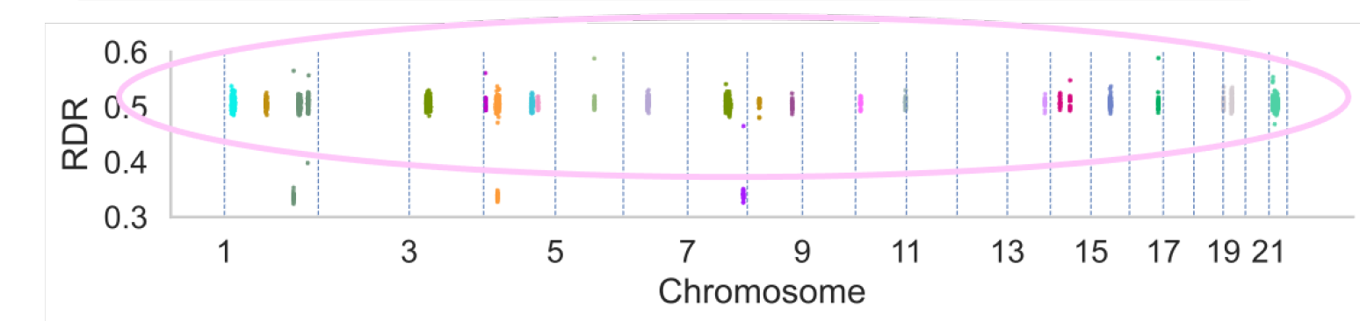
Simulated Data: Before and After CNAViz
Simulated Results: Before and After CNAViz

Slide 19
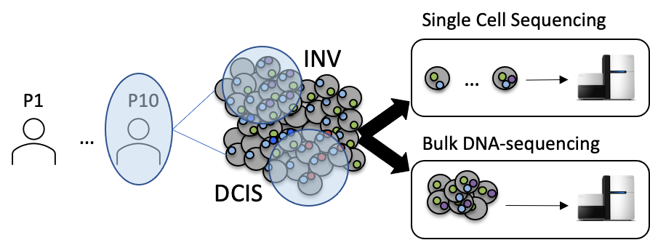
Real Data: Context
Real Data: Context
[Casasent et al. Cell 2018]
Notes:
Next we wanted to explore whether this segmentation improvement actually translated to improvements in copy number calling.
6 tumor samples from 2 breast cancer patients
We run segmentation methods on the bulk DNA sequencing data, and then improve the segmentation with CNAViz, then run copy number calling.
We compared those ending insights to the insights found on single cell sequencing.

Slide 20
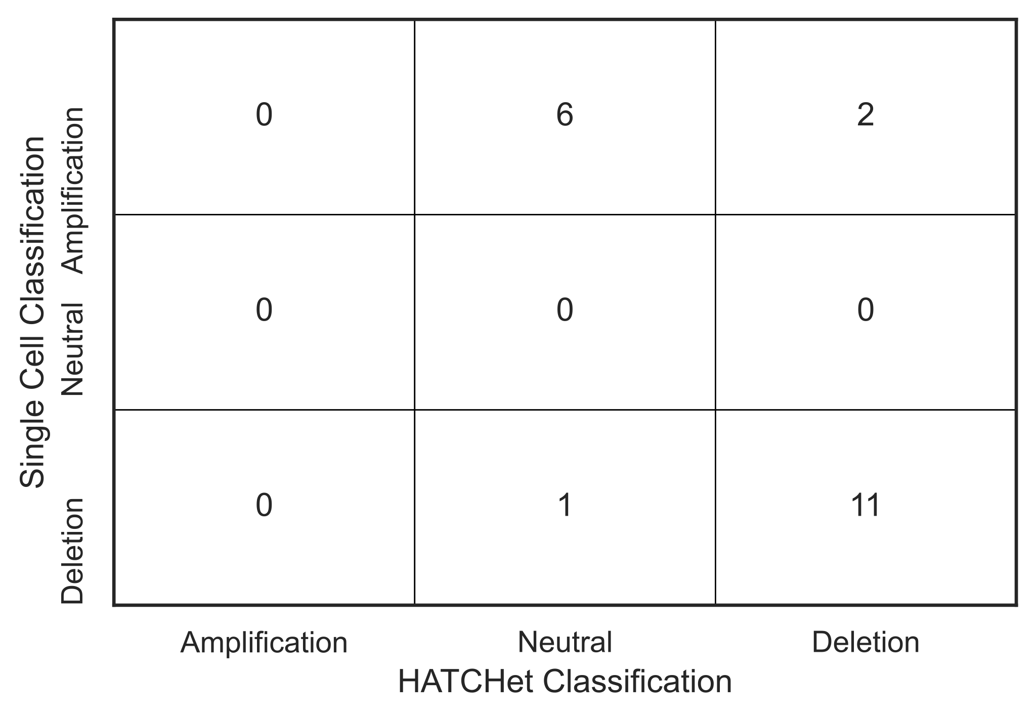
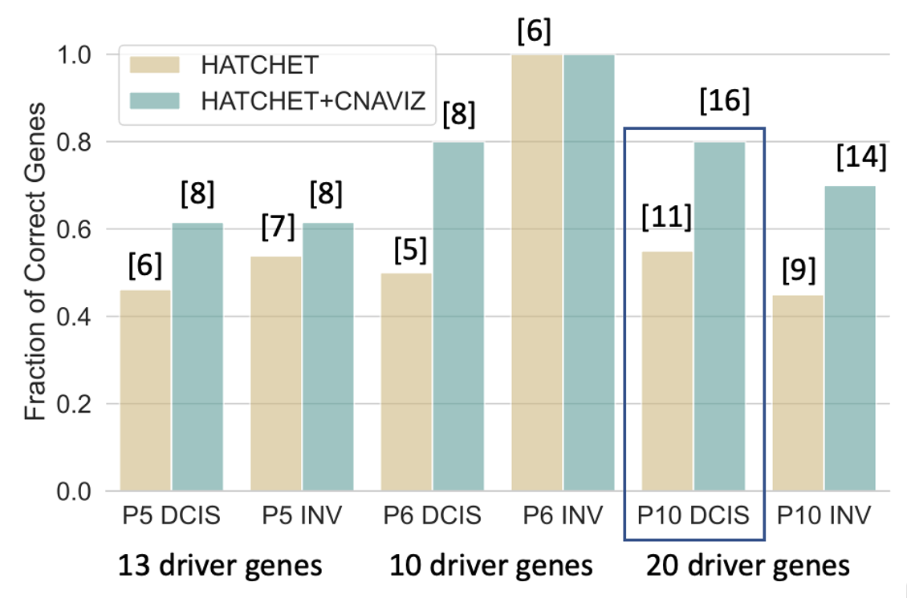
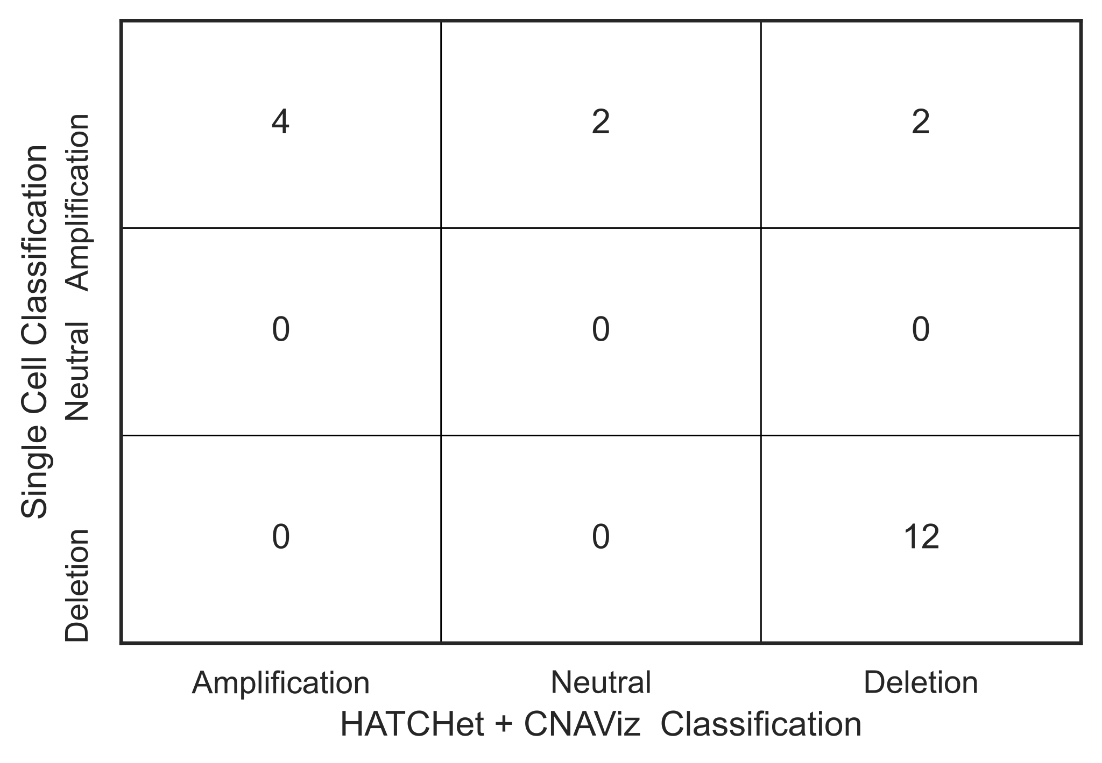
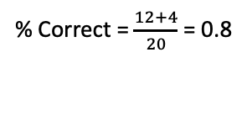
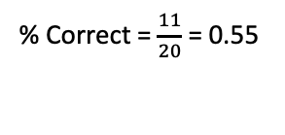
Real Data: Results
Real Data: Context
0
% Correct = $\frac{11}{20}$ = 0.55
0
Oncogenes
MYCN
MLLT11
TRIM24
0
11
Tumor Suppressors
LIFR
4
% Correct = $\frac{12+4}{20}$ = 0.8
0
MYCN
MLLT11
TRIM24
12
Tumor Suppressors
LIFR
Notes:
confusion matrix for one matrix would be helpful
based on the single cell sequencing data as ground truth

Slide 21
Conclusions & Discussion
Conclusions & Discussion
CNAViz can be used to improve copy-number calling on noisy sequencing data.
All examples were on bulk but same applies to single cell
Future Work:
Automating CNAViz insights
Modeling cohort effects
Real-time suggestions
Generate generalizable suggestions based on cohort tumor data
Crowd-sourcing segmentation solutions on public datasets (e.g. BCBA, ICGC)

Slide 22





Overview
Acknowledgements
Thank you for your attention!
Questions?
Thanks to Zubair, Mohammed, Simone and the rest of the El-Kebir lab!
Availability: https://elkebir-group.github.io/cnaviz/
COMPUTER SCIENCE
GRAINGER ENGINEERING
Notes:
copy from paper

